Slide 1

SRI VENKATESWARA COLLEGE OF ENGINEERING, TIRUPATI
HACK-VOUCHER
DEPARTMENT OF COMPUTER SCIENCE AND ENGINEERING
Under the guidance of : Presented By :
Dr. K SANTHI, Ph.D Dulla Pravalika - 19BF1A0545
Associate Professor Gunda Sudarrshan - 19BF1A0554
Putturu Nivas - 19BF1A0569
Chakram Joycy Ikya - 19BF1A0527

Slide 2
CONTENTS
ABSTRACT
INTROUCTION
OBJECTIVE
EXISTING SYSTEM
TECHNOLOGIES USED
PROPOSED SYSTEM
ADVANTAGES
CONCLUSION
REFRENCES

Slide 3
ABSTRACT
As a result of the pandemic, our country has undergone a wave of digital transformation over the past two years. As a result of lack of choice, concerns about safety, or just convenience, consumers have been taking to digital means to fulfill their needs. This change in behavior boosted the growth of the e-commerce industry in India. Due to an increase in internet and smartphone penetration, that segment had already experienced rapid growth, but the pandemic tripled it. it. Payments for everything, from groceries to clothes to books to personal care products, are now made online. This has led to the growth of e-commerce companies like Flipkart, Amazon, and Myntra, Zomato etc., that offer vouchers/gifts cards to promotes the online transactions and payments.

Slide 4
INTRODUCTION
It is an online market place where user sell and buy the voucher that they get from different e-commerce website like google pay, amazon pay, BHIM , UPI etc. and are of no use for a particular user but useful for other. So basically, In this Project which we are building, voucher hosting platform where user can sell vouchers there and can purchase useful vouchers like discount coupons, cashback coupons etc in exchange of a point that is to be added in their wallet.

Slide 5

OBJECTIVE
The aim of this project is to provide to the users, a full stack web application that will be useful for using a voucher that are provided by different ecommerce site as a gift like Flipkart, Google Pay. By this application users can easily buy and sell vouchers with the wallet money.

Slide 6
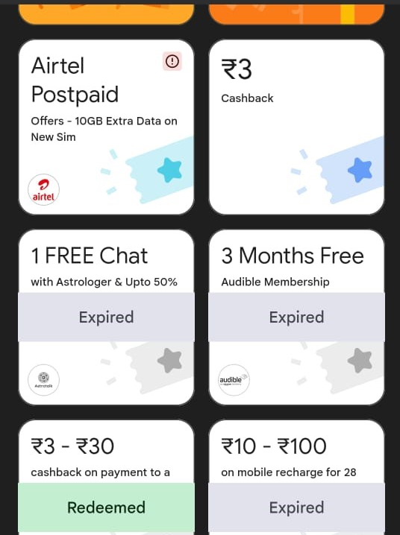
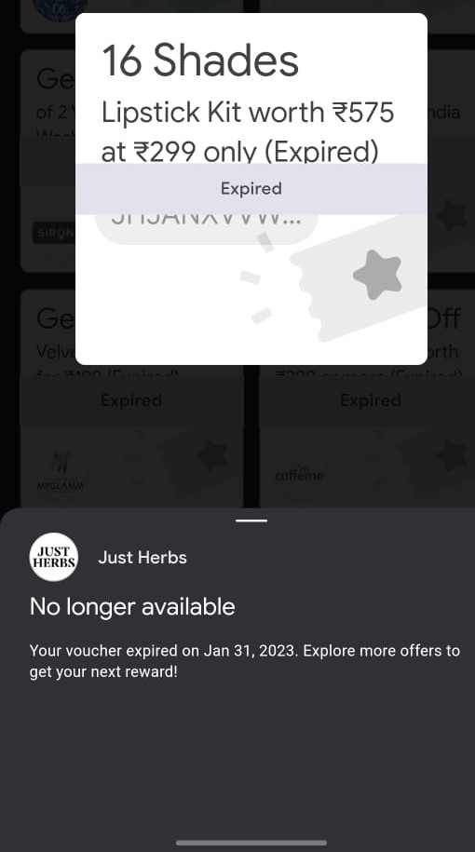
EXISTING SYSTEM

Slide 7
TECHNOLOGY USED
GUI Frontend - HTML/CSS, Bootstrap, JavaScript
Backend- NodeJS, ExpressJS
IDE- Visual Studio Code
Version Control System- Git ,Github
Other tools

Slide 8
proposed system
We can also include a section for negotiation where users can negotiate on purchasing and selling of vouchers and gift cards. This feature is available to only logged in users
We can also develop android apps and launch on play store. Android app make more interactive UI and easy to use for users
We can also implement filter such a way that user view voucher of their interest and also get a notification on their profile and email when someone added a voucher of their interest.
We will include automate verification of vouchers.

Slide 9
ADVANTAGES
Easier availability of coupons.
Best Advantage for sender.
Negotiation of coupons.
Multiple sharing.

Slide 10
CONCLUSION
The end result of the mentioned methodology and planned action will be a highly interactive UI with working functionalities of a Hack -voucher, which will keep user data secure and will be able to handle customized coupon/gift card search for an user. This web application aims to eliminate the wastage of unused vouchers/gift cards. We also get some bank discounts, coupons from shopping websites like myntra, flipkart, amazon. Some trading account coupons that are of no use to us, but can be useful to others. Our Platform provide users coins in exchange of money that is our profit to earn money.

Slide 11
REFRENCES
https://www.geeksforgeeks.org/
https://www.researchgate.net/publication/283699248_Gift_cards_a_review_and_research_agenda
https://www.persistencemarketresearch.com/market-research/gift-card-market.asp
https://stackoverflow.com/
https://www.tutorialspoint.com/index.htm
https://w3schools.com/

Slide 12
THANK YOU

